Slide 1
The Vector Space Model (VSM)

Slide 2
Documents as vectors
Sec. 6.3
Now we have a |V|-dimensional vector space
Terms are axes of the space
Documents are points or vectors in this space
Very high-dimensional: tens of millions of dimensions when you apply this to a web search engine
These are very sparse vectors – most entries are zero

Slide 3
Queries as vectors
Sec. 6.3
Key idea 1: Do the same for queries: represent them as vectors in the space
Key idea 2: Rank documents according to their proximity to the query in this space
proximity = similarity of vectors
proximity ≈ inverse of distance
Recall: We do this because we want to get away from the you’re-either-in-or-out Boolean model
Instead: rank more relevant documents higher than less relevant documents

Slide 4
Formalizing vector space proximity
Sec. 6.3
First cut: distance between two points
( = distance between the end points of the two vectors)
Euclidean distance?
Euclidean distance is a bad idea . . .
. . . because Euclidean distance is large for vectors of different lengths.

Slide 5
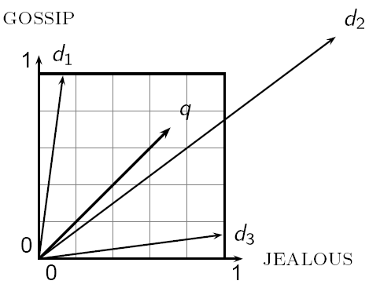
Why distance is a bad idea
Sec. 6.3
The Euclidean distance between q
and d₂ is large even though the
distribution of terms in the query q and the distribution of
terms in the document d₂ are
very similar.

Slide 6
Use angle instead of distance
Sec. 6.3
Thought experiment: take a document d and append it to itself. Call this document d′.
“Semantically” d and d′ have the same content
The Euclidean distance between the two documents can be quite large
The angle between the two documents is 0, corresponding to maximal similarity.
Key idea: Rank documents according to angle with query.

Slide 7
From angles to cosines
Sec. 6.3
The following two notions are equivalent.
Rank documents in decreasing order of the angle between query and document
Rank documents in increasing order of
cosine(query,document)
Cosine is a monotonically decreasing function for the interval [0º, 180º]

Slide 8
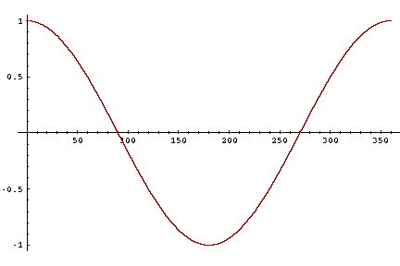
From angles to cosines
Sec. 6.3
But how – and why – should we be computing cosines?

Slide 9
Length normalization
Sec. 6.3
A vector can be (length-) normalized by dividing each of its components by its length – for this we use the L₂ norm:
Dividing a vector by its L₂ norm makes it a unit (length) vector (on surface of unit hypersphere)
Effect on the two documents d and d′ (d appended to itself) from earlier slide: they have identical vectors after length-normalization.
Long and short documents now have comparable weights

Slide 10
cosine(query,document)
Sec. 6.3
Dot product
Unit vectors
q_{i} is the tf-idf weight of term i in the query
d_{i} is the tf-idf weight of term i in the document
cos(q,d) is the cosine similarity of q and d … or,
equivalently, the cosine of the angle between q and d.
Notes:
See Law of Cosines (Cosine Rule) wikipedia page

Slide 11
Cosine for length-normalized vectors
For length-normalized vectors, cosine similarity is simply the dot product (or scalar product):
for q, d length-normalized.

Slide 12
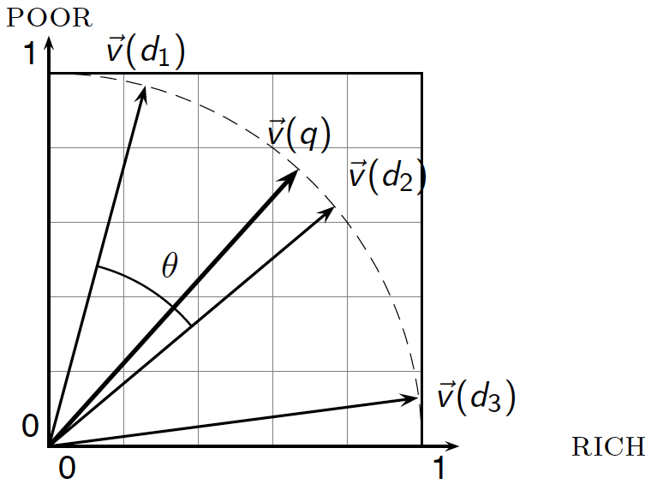
Cosine similarity illustrated

Slide 13
Cosine similarity amongst 3 documents
Sec. 6.3
How similar are
the novels
SaS: Sense and
Sensibility
PaP: Pride and
Prejudice, and
WH: Wuthering
Heights?
term | SaS | PaP | WH
affection | 115 | 58 | 20
jealous | 10 | 7 | 11
gossip | 2 | 0 | 6
wuthering | 0 | 0 | 38
Term frequencies (counts)
Note: To simplify this example, we don’t do idf weighting.

Slide 14
3 documents example contd.
Sec. 6.3
Log frequency weighting
After length normalization
term | SaS | PaP | WH
affection | 3.06 | 2.76 | 2.30
jealous | 2.00 | 1.85 | 2.04
gossip | 1.30 | 0 | 1.78
wuthering | 0 | 0 | 2.58
term | SaS | PaP | WH
affection | 0.789 | 0.832 | 0.524
jealous | 0.515 | 0.555 | 0.465
gossip | 0.335 | 0 | 0.405
wuthering | 0 | 0 | 0.588
cos(SaS,PaP) ≈
0.789 × 0.832 + 0.515 × 0.555 + 0.335 × 0.0 + 0.0 × 0.0 ≈ 0.94
cos(SaS,WH) ≈ 0.79
cos(PaP,WH) ≈ 0.69
Why do we have cos(SaS,PaP) > cos(SAS,WH)?

Slide 15
The Vector Space Model (VSM)

